Slide 1
Painter Demo
Yanfei Wang, Kuncheng Fang, Wenjie Li, Juexu Yang
Sep 26th, 2017

Slide 2
MFC Based Painter
Yanfei Wang

Slide 3
MFC Painter Function:
Rotation
Gray Scale
Negative
Woodcut
Carve
Relievo

Slide 4
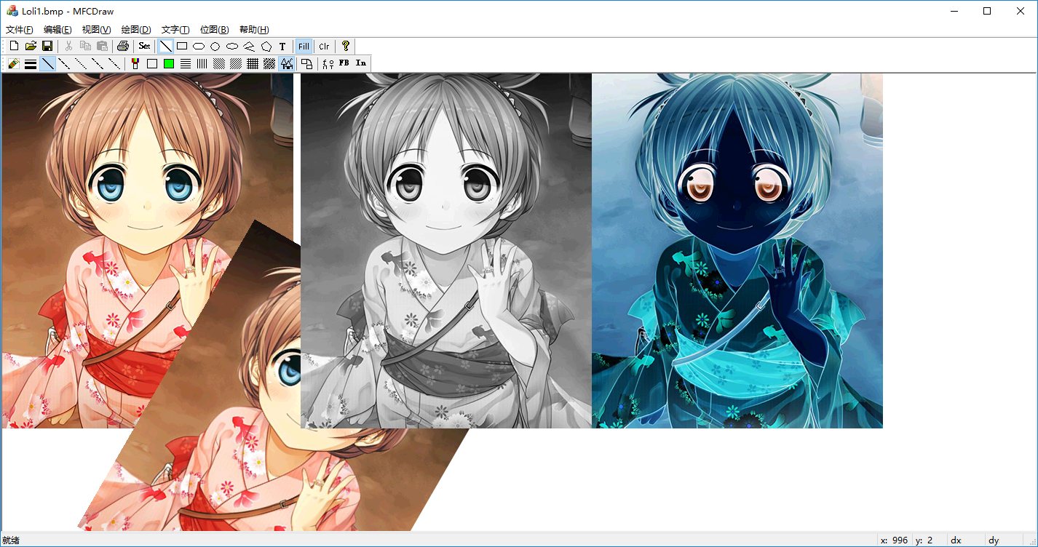
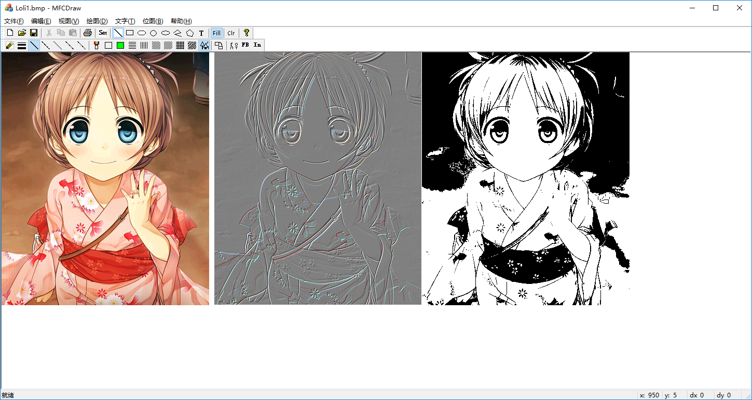
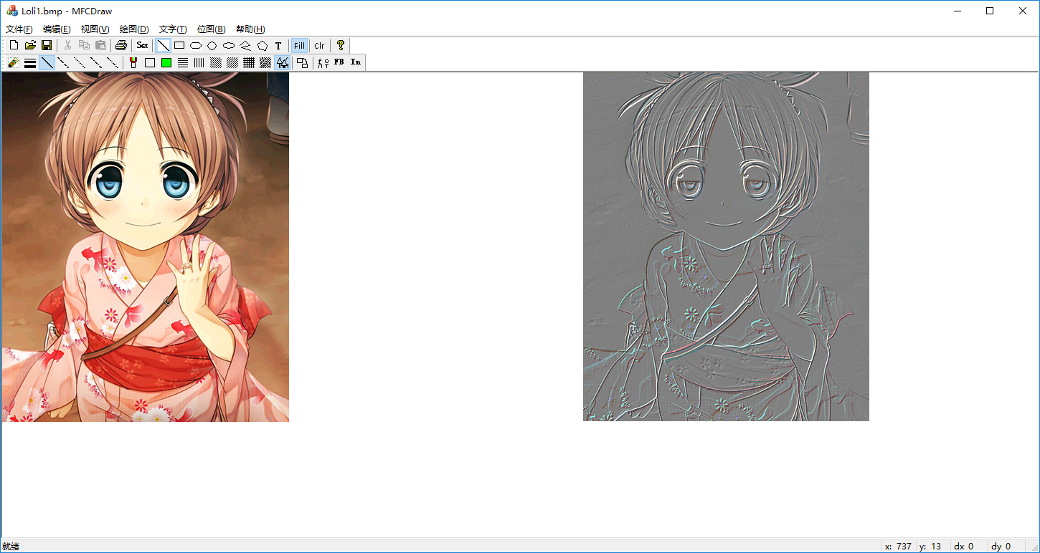
Screenshots

Slide 5
Win32API Based Painter
Juexu Yang

Slide 6
Win32API Painter Function:
Load/Save Images and 3D Files
Pen Scrawling
Gaussian Blur
Grey Scale
Realtime Rendering with FPS counting
SSAA Anti-aliasing

Slide 7
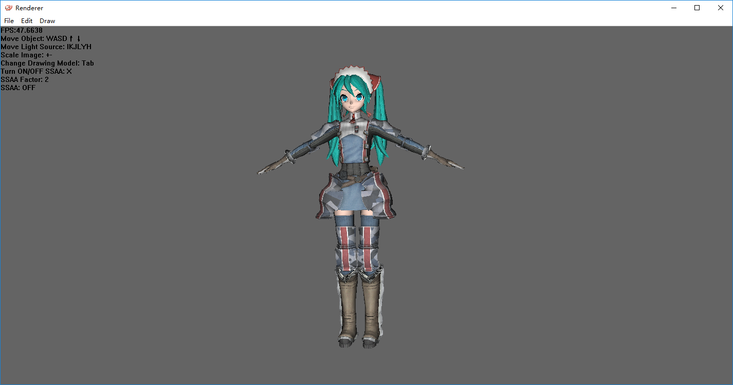
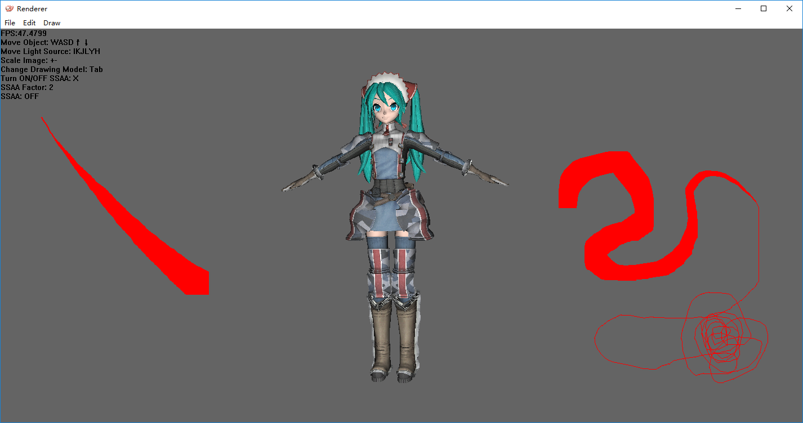
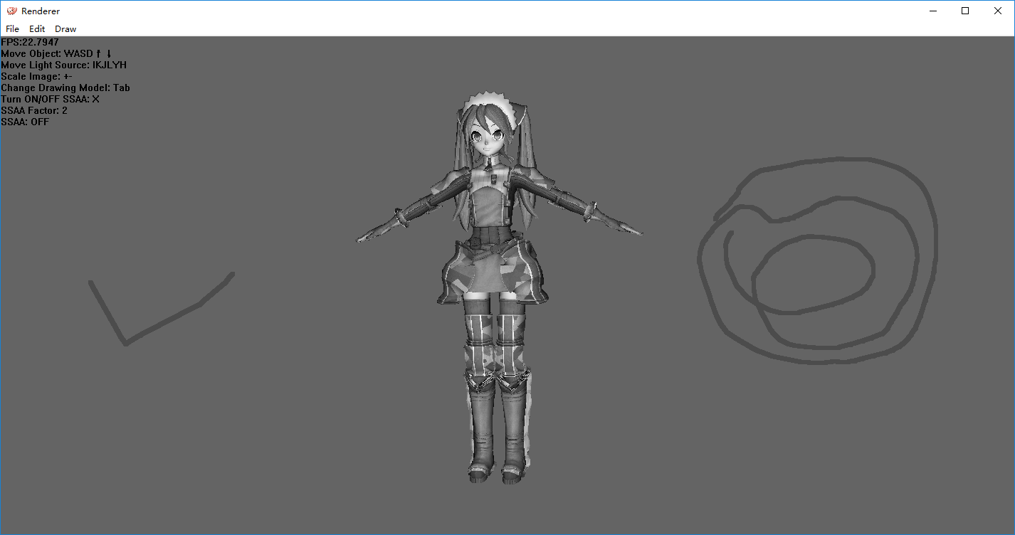
Screenshots

Slide 8
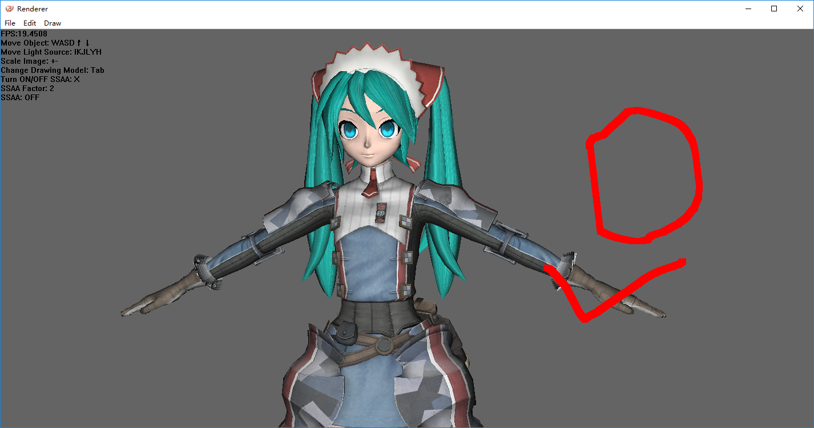
Gaussian Blur Before

Slide 9

Gaussian Blur After

Slide 10
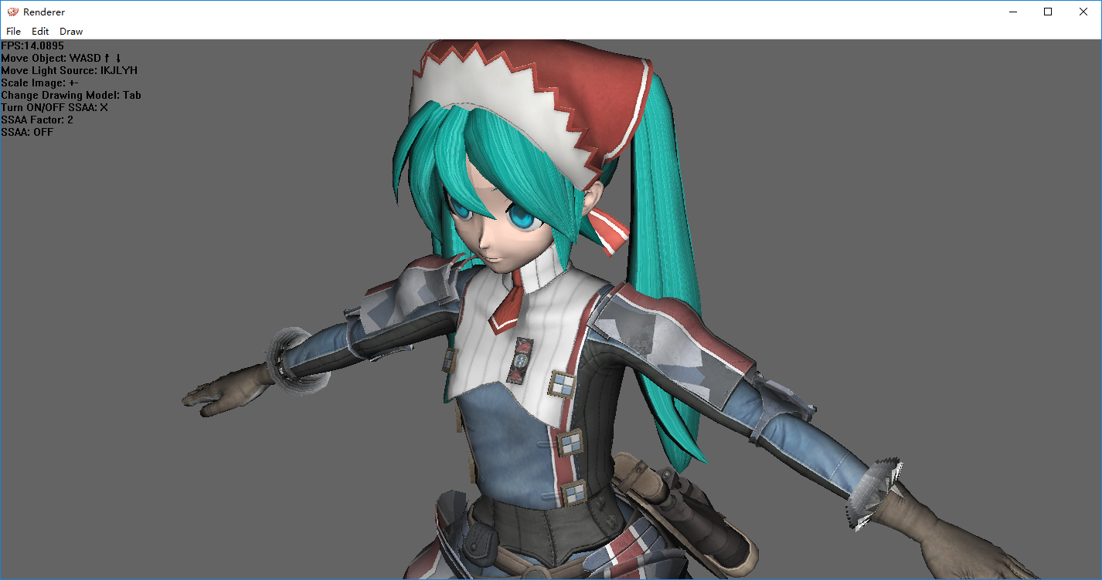
Anti-aliasing Before

Slide 11

Anti-aliasing After

Slide 12
Turn Dotted-Pen into Continuous Pen
Bresenham Algorithm

Slide 13
Cater to Human Eyes
Grey Scale
Intensity = 0.333 * R + 0.333 * G + 0.333 * B
Intensity = 0.299 * R + 0.587 * G + 0.114 * B

Slide 14
Super-sampling Anti-aliasing
SSAA
Average Pooling
4X Jagged Image
1X Smooth Image

Slide 15
Q & A

Slide 16
Thanks!

